Slide 1
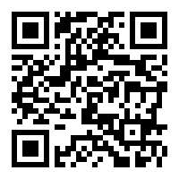
Computing and Graphics in Applied Statistics Online Instruction
LECTURE 25/April 24, 2020
Please mute yourself after joining. Unmute when you wish to speak.
This session is being recorded and will be available in Canvas.
Last class (recorded and available on Canvas)
Completed power and sample size computations/simulations
Today and next classes
Naïve Bayes Classifier, Bayes Regression
Study guide, Projects (4/28, 5/1)
Last HW assigned due on 5/1 and answers posted on 5/2
Student Instructional Rating Survey opened through May 7. Please complete – your feedback is important.
https://sirs.ctaar.rutgers.edu/blue QR code
Study guide for Test 2 will be available on April 28 (Last class is on May 1)
Index | Section | Exam Code | Final Exam Day and Time
12976 | 01 | C | Thursday, May 07, 2020: 12:00 PM - 3:00 PM

